Slide 1
Analysis of Electric Vehicle Adoption Trends Using Descriptive Analytics
Braimoh elizabeth

Slide 2
INTRODUCTION
Electric Vehicles (EVs) are replacing traditional fuel-based vehicles
Driven by environmental concerns and government policies
EV adoption is increasing globally and in India
Data analytics helps in understanding adoption patterns
Electric vehicles are gaining popularity due to rising fuel prices and environmental issues. Governments are promoting EV adoption, and analyzing sales data helps understand how this transition is happening over time.

Slide 3
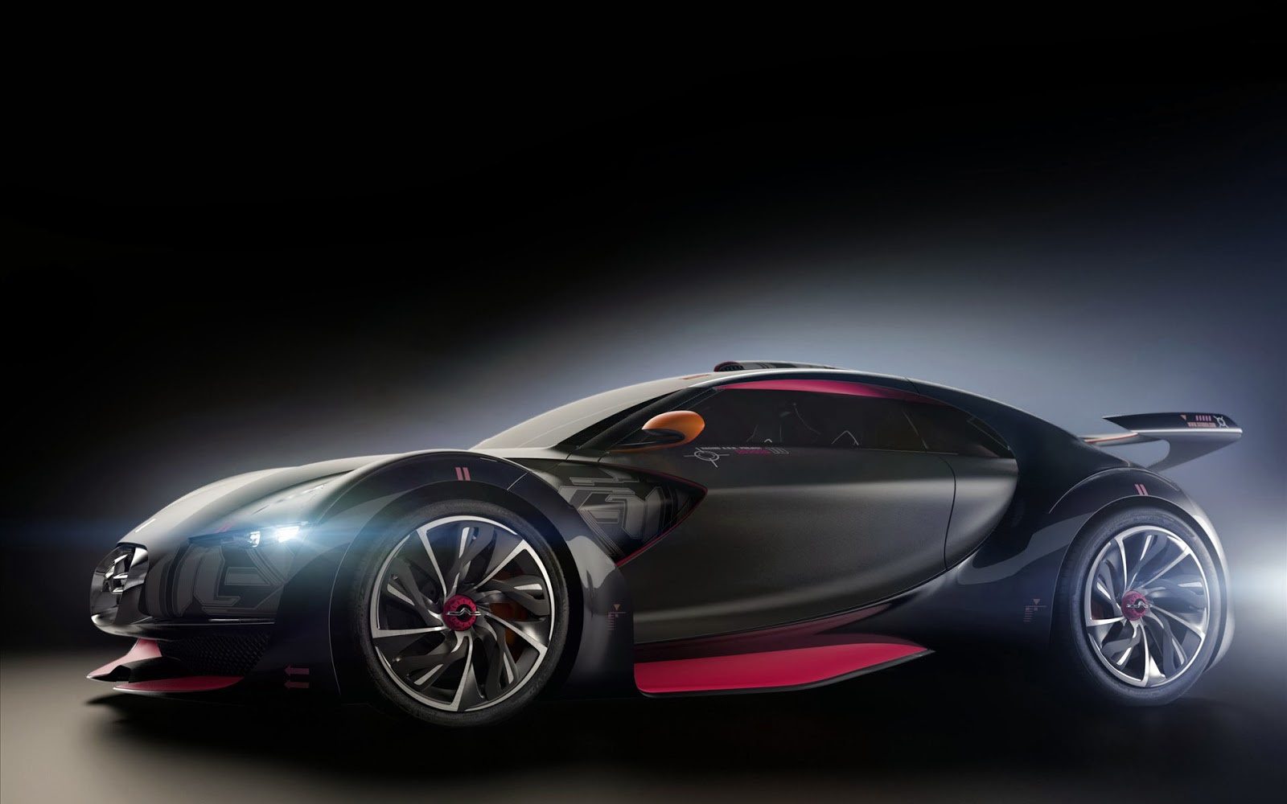
AIM OF THE STUDY
Analyze EV adoption trends
Identify sales patterns
Study regional and category differences
This Photo by Unknown Author is licensed under CC BY-NC-ND

Slide 4
OBJECTIVES
Monthly & yearly analysis
State-wise comparison
Vehicle category analysis
Visualization of trends

Slide 5

DATASET DESCRIPTION
Year, Month, Date
State information
Vehicle class & type
EV sales quantity

Slide 6
METHODOLOGY
Data collection (CSV file)
Data cleaning
Aggregation and grouping
Descriptive analysis
Visualization

Slide 7
TOOLS USED
Python
Pandas
NumPy
Matplotlib
Seaborn
Plotly

Slide 8
Monthly EV Sales Trend
Month | EV Sales
Jan | 360,703
Feb | 228,739
Mar | 299,888
Apr | 232,194
May | 262,747
Jun | 229,754
Jul | 270,473
Aug | 294,022
Sep | 313,433
Oct | 355,083
Nov | 382,217
Dec | 364,558

Slide 9
YEARLY EV GROWTH
Continuous increase in EV adoption
Strong growth in recent years
Indicates rising demand for EVs

Slide 10
STATE-WISE ANALYSIS
EV adoption is uneven across states
Some states dominate EV sales
Others show slower adoption

Slide 11
VEHICLE CATEGORY ANALYSIS
2-wheelers dominate EV market
3-wheelers show strong growth
4-wheelers growing steadily
Heavy vehicles still low adoption

Slide 12
KEY FINDINGS
EV adoption is increasing year by year
Strong regional variation exists
Small vehicles dominate the market
Infrastructure impacts adoption rate

Slide 13
CONCLUSION
EV market is growing rapidly
Adoption driven by policy & demand
Descriptive analytics helps understand trends
Supports data-driven decisions

Slide 14
RECOMMENDATIONS
Improve charging infrastructure
Increase EV subsidies
Focus on low-adoption states
Promote awareness programs
Support EV manufacturing

Slide 15
THANK YOU
Thank You! Questions?

